Slide 1

Solar Powered Irrigation System with Intruder Detection

Slide 2
Project Team & Mentors
Ms. Pooja – Mentor
Prajwal Srivastava – Team Leader
Mohit Jain
Mukund Rastogi

Slide 3
Problem Statement
Promote Value added agricultural processes, products and handicrafts.

Slide 4
IntRoduction
The aim of this project is to develop a solution that reduces the manual labour of farmer, and protect the crop against unwanted intruders.
Additionally this project aims on conserving electricity by using solar energy to power all the setup, which in turn is beneficial for our environment.

Slide 5
Similar products available
The product that performs similar function is sprinkler.
Its Disadvantages:
It consumes high amount of electricity, whereas our project uses solar energy.
It doesn’t provide the farmer with same level of controls to turn on/off the irrigation system as per their needs.
It doesn’t protect the crops against intruders/animals.

Slide 6
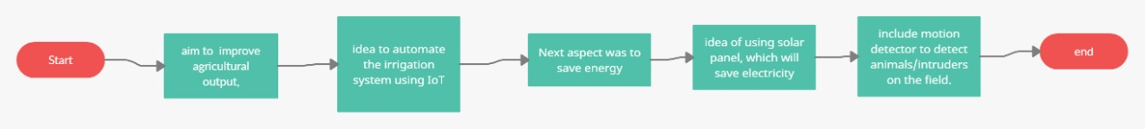
Workflow

Slide 7
End-user functionalities
The end user can configure the device very easily that will automatically turn the motor on/off.
End User will get an application using which they can remotely turn on/off their motor.
All of these devices will be powered by solar energy, ultimately conserving electricity.
An intrusion detection system that will ring an alarm by detecting motion using PIR sensor on the field.

Slide 8
conclusion
This project aims to increase the output of the farmer, while conserving energy and providing automation using modern technologies such as IoT to help them them focus on what’s necessary.
It also helps farmer to provide a degree of protection to their crops against intruder/animals.

Slide 9

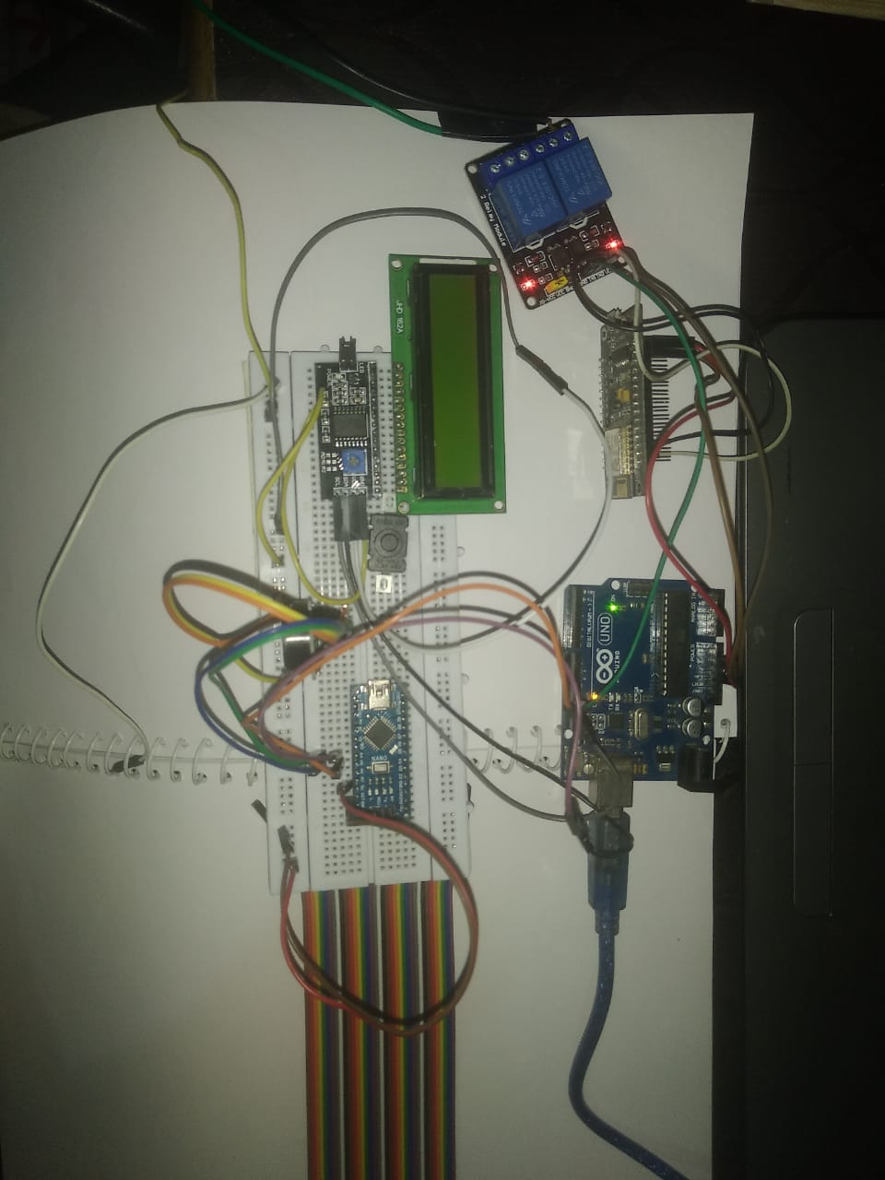
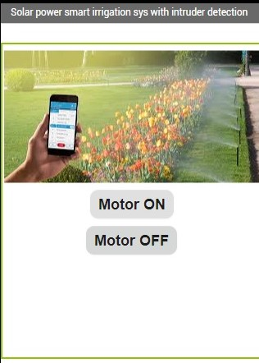
Peek into the project

Slide 10
References
https://innovate.mygov.in/innovation/automatic-irrigation-system/
https://www.elprocus.com/microcontroller-based-automatic-irrigation-system/
https://circuitdigest.com/microcontroller-projects/arduino-automatic-plant-watering-system
https://www.electronicshub.org/arduino-pir-sensor-tutorial/

Slide 11

THANK YOU

